Slide 1
Model Evaluation
Once you’ve trained some models, how do you figure out which of them is best?
Adapted from https://www.youtube.com/playlist?list=PLCof9EqayQgt6iSJnt8ABPhMNiU2hmZiK https://mlvu.github.io/lectures/21.Methodology1.annotated.pdf Nov 6, 2021

Slide 2
This presentation can serve as a guide on how to successfully evaluate a machine learning model.
While it’s almost impossible to tell how your model would behave in the real world, model evaluation helps to give a sense of what to expect after deployment.

Slide 3

Performing
Experiments

Slide 4
Why do we need Experiments?
An experiment is a procedure carried out to support or refute a hypothesis (https://en.wikipedia.org/wiki/Experiment)
When you think about the world of building machine models you’re basically proposing a solution to a problem that might have a baseline performance and the best way to prove that your solution is better is to carry out an experiment.
It’s important to think of Model Evaluation as an experiment, because every time you train your algorithm against your dataset and produce a model you’re essentially running an Experiment and how well you follow established principles is critical to the performance of your solution/model.

Slide 5
Establishing a Baseline
Establishing a baseline performance is the very first step when performing an experiment, because that’s the only way you can verify that your proposed model is worthy to solve the problem at hand.
Example : Building a Credit Risk Model is better than randomly selecting different loan applicants or using a new SVM algorithm is better than existing kNN algorithm for a recommender system.

Slide 6
Measuring experiments
To be able to measure experiments we need Performance Metrics to measure how good or bad it’s solving the problem at hand.
E.g How well is a classifier good at classifying a borrower as a defaulter
Note : We have to compute these performance metrics for both the baseline and the new solution/model

Slide 7
Choosing Performance Metrics - Regression
Typically the Mean Squared Error is used as a loss function that the regression algorithm seeks to minimize but when it comes to choosing a performance metric that we can easily interpret the Root Mean Squared Error is used because it has the same units as the original output value
For instance, if your outputs are in meters, then your MSE is measured in square meters but your RMSE is also measured in meters.
When evaluating the Root Mean Squared Error the two concepts are important
Bias
Variance

Slide 8
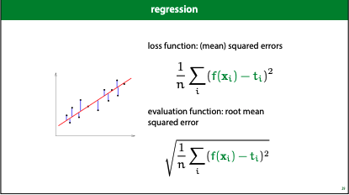
Root mean squared error
f(x) | t
56 | 60
45 | 44
67 | 60
55 | 52

Slide 9
Bias & Variance
To understand the results of a regression experiment better and be able to interpret error, bias and variance are important concepts.
Bias - All the errors introduced by the limitation of the model
Variance - All the errors introduced by the randomness in sampling the data

Slide 10
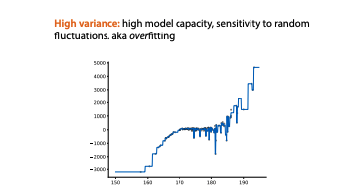
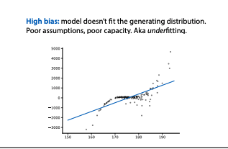
Overfitting & Underfitting
Overfitting
Underfitting

Slide 11
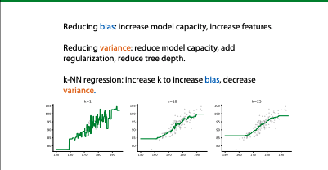
How to reduce high bias & variance

Slide 12
Choosing Performance Metrics - Classification
Confusion Matrix is the most fundamental performance metric for Classification tasks, out of it came more detailed concepts like
True positive rate
False positive rate
Precision
Recall
AUC ROC

Slide 13
Classification
We’ve seen how RMSE, bias and variance can be used to evaluate regression experiments.
For classification to be able to interpret errors you need to understand the following concepts
Class Imbalance
Cost Imbalance

Slide 14
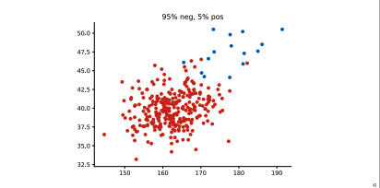
Class Imbalance
Class imbalance occurs positive and negative class aren’t the same proportion in your dataset. Imbalance is a normal phenomenon but poses a problem when it’s extreme.

Slide 15
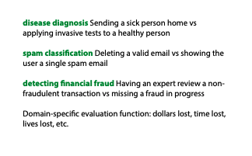
Cost Imbalance
In classification problems one misclassification one way costs much more than a misclassification the other way.

Slide 16
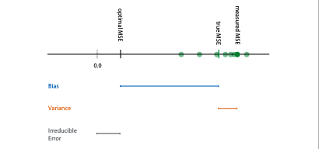
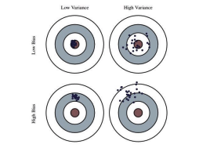
Bias & Variance

Slide 17
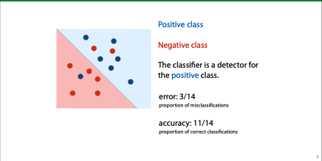
Accuracy & Error
For binary classification tasks the simplest form of performance metrics are Accuracy & Error

Slide 18
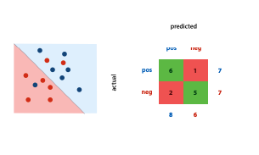
Confusion Matrix
This is a good way to get insight into what your classifier is actually doing in terms of predicting positive classes as positive and negative classes as negative.

Slide 19
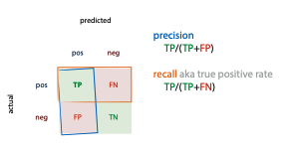
Precision & Recall
Precision & Recall are derived from the Confusion Matrix.
Precision is the proportion of the returned positives that are actually positive
Recall is the proportion of the existing positives that was found

Slide 20
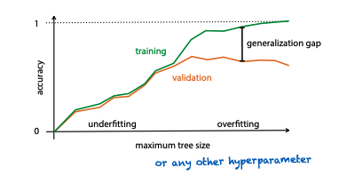
Fitting problems in Classification and how to detect it.
To be able to tell when your model is either underfitting or overfitting, you can use the difference between the validation and training error.

Slide 21


True Positive Rate (TPR) and False Positive Rate (FPR)
A good pair of metrics to consider, especially when we have class imbalance is the TPR & FPR
TPR : What proportion of the actual positives did we get right. (The higher the better)
FPR : What proportion of the actual negatives did we get wrong. (The lower the better)

Slide 22
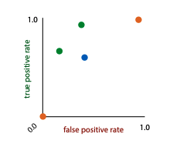
ROC Curve
ROC stands for Receiver-Operating-Characteristic and it makes use of the TPR and FPR space
Since we want to get the TPR as high as possible and the FPR as low as possible, this means the TPR/FPR space has the best classifier in the top left corner.

Slide 23
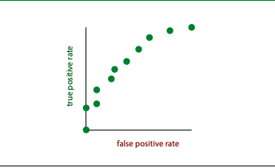
ROC Curve

Slide 24
Ranking Classifiers
To be able to plot the ROC Curve we can achieve this by turning a regular classifier into a ranking classifier.
A ranking classifier does more than just classifying data points and goes further to give a score on how negative or positive a point is.
To determine how negative or positive a point is, we measure the distance to the decision boundary and the curve is plotted as the threshold for the decision boundary moves from left to right

Slide 25
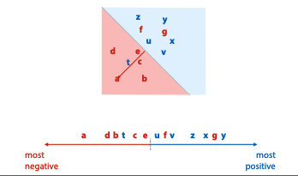
Ranking Classifier

Slide 26

Ranking Error
To be able to judge our Ranking Classifier we need the ranking error because it tells us which pairs are ranked the wrong way around.
t and f form a ranking error; t is ranked as more negative than f, even though t is positive and f is negative.

Slide 27
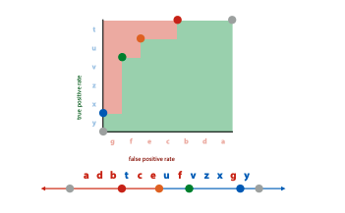
Coverage Matrix
This shows us what happens to the TPR & FPR if we move the threshold from right to left.

Slide 28
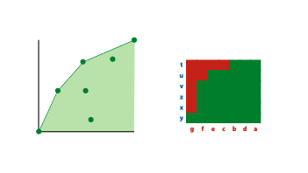
AUC-ROC
Area Under the Curve (AUC) is a good way of judging the quality of a classifier by assessing how much area under the ROC space it covers, the bigger the area the more useful the classifier in predicting positive examples as positive and negative examples as negative.

Slide 29
AUC-ROC
The AUC (in ROC space) is an estimate of the probability that a ranking classifier puts a randomly drawn pair of positive and negative examples in the correct order
You can calculate an AUC Score by using the Simpson’s Rule the bigger the score the better.
Note : How we get a ranking classifier depends entirely on the model.

Slide 30
PR-ROC
The precision/recall curve in the ROIC space is a very similar metric to AUC-ROC but instead of the TPR & FPR on the axes it has Precision & Recall on it’s axes.

Slide 31
Comparing Models in an Experiment
Model comparison during experiments can be approached from two world views
Comparing different model classes (Logistic Regression VS Trees VS kNN)
Comparing hyperparameters of a single model class (different values of k, for the kNN model)

Slide 32
Comparing Models in an Experiment
Whether you’re comparing different model classes or just comparing several values for a single hyperparameter of a model class, you’d need to compute the Performance Metrics that was chosen for the Experiment
Train Model A, Train Model B
Compute Performance Metric A, Compute Performance Metric B
Depending on the domain of the Performance Metric (The lower the better / The higher the better)

Slide 33
Selecting Data for Experiments
Selecting data for experiments is very critical to building robust models and there are two factors to have at the back of mind while performing experiments (training models)
On which data do we compute the error? Ensure you using the right data splitting Strategy.
How do we eliminate random Effects? Avoid Testing Multiple things at the same time on the dataset and avoid re-using your test data

Slide 34
Data Splitting Strategy
To successfully carry out an experiment you need to split your data into train & test set.
Training set is only used for choosing your model and it’s hyperparameters
Test set is used for testing your hypothesis

Slide 35
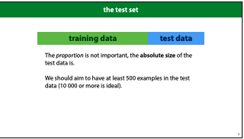
Data Splitting Strategy
A typical split would be a 80(Train)/20(Test) split but it isn’t a rigid rule and you can make use of other splits like 70/30 or 60/40.
A good rule of thumb is to always ensure that your train proportion is always greater than than test.
In some use cases like credit risk, time is an important factor and you have to order the whole dataset from the earliest to the latest

Slide 36
Don’t re-use your test data!
Just to emphasize the important point:
The more you use the test data, the less reliable your conclusions become
Not only does reusing test data mean that you pick the wrong model, it also means that the error estimate you get is probably much lower than the error you would actually get if you gathered some more test data.

Slide 37
How to make the most of your training set
Since we have to split the data into and train set this now limits the number of observations available for training your model, It’s common practice to create the validation set.
The validation set is usually the same size as your test set but you can make it a little smaller to get some more training data

Slide 38
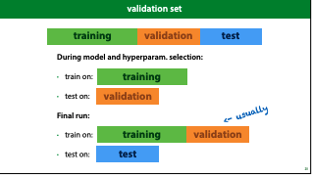
Validation data

Slide 39
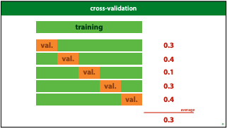
You can even make better use of your training data by using cross-validation

Slide 40
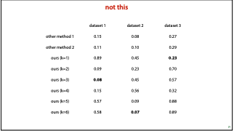
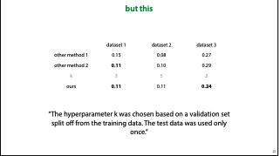
Reporting Experiment Results
Avoid Testing Multiple things at the same time on the same dataset!

